Slide 1

Addressing Voice-based Fraud with AI
Developing Effective Countermeasures against Identity Personification
Voice Detectives
Krishna Kumar Sabbu
Naresh Palabatla
Padma Naresh
Ravi kiran
Sai Tejaswi
Chandra Sekhar Javalkar

Slide 2
Problem Statement
Voice-based fraud, using AI-generated voice prints, threatens security by allowing unauthorized access to sensitive information.
Current voice authentication methods are vulnerable to sophisticated attacks, requiring robust countermeasures to accurately differentiate between genuine and AI-generated voices.
The challenge involves developing AI algorithms to analyze speech patterns and incorporate liveness detection, meeting requirements for scalability, reliability, security, and accuracy.

Slide 3

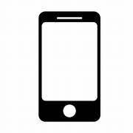












Design Flow
Load Audio
wave files
Training
Trained
Model
?
Resize to fixed length
Audio wave files
Classifier
Fraud detection
Emotions
Human
Both
AI
Background noise
Training flow
Language
Analysis flow

Slide 4
Non-Functional Requirements (NFRs)
Scalability :
- The system should be capable of handling a growing number of voice verification requests without compromising performance with API Response time of < 1 second per request.
Cost Efficiency :
- The system is developed without any AI related cloud service which significantly reduce operational costs.
Usability :
- We have created a user friendly web app to detect the voice sample.
Accuracy :
- The system accurately distinguish between authentic and AI-generated voice prints.
Generalizability :
- The system is effective across various voice domains, accents, and speaking styles.

Slide 5







Deployment Diagram
Dev Team
GCP Cloud Run
{docker image}
Https
App Service
Build Flow
Deployment Flow

Slide 6
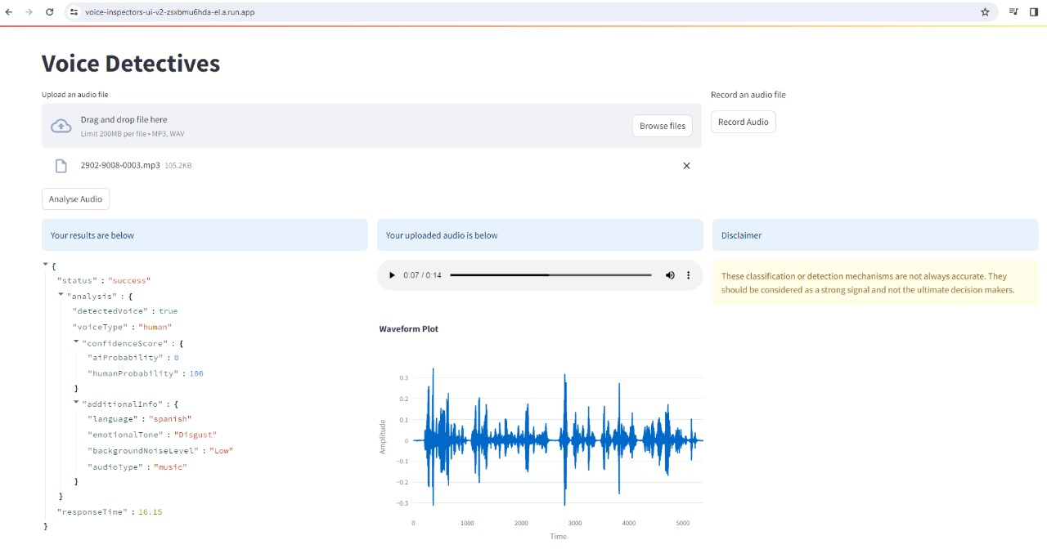
Voice Detective App

Slide 7
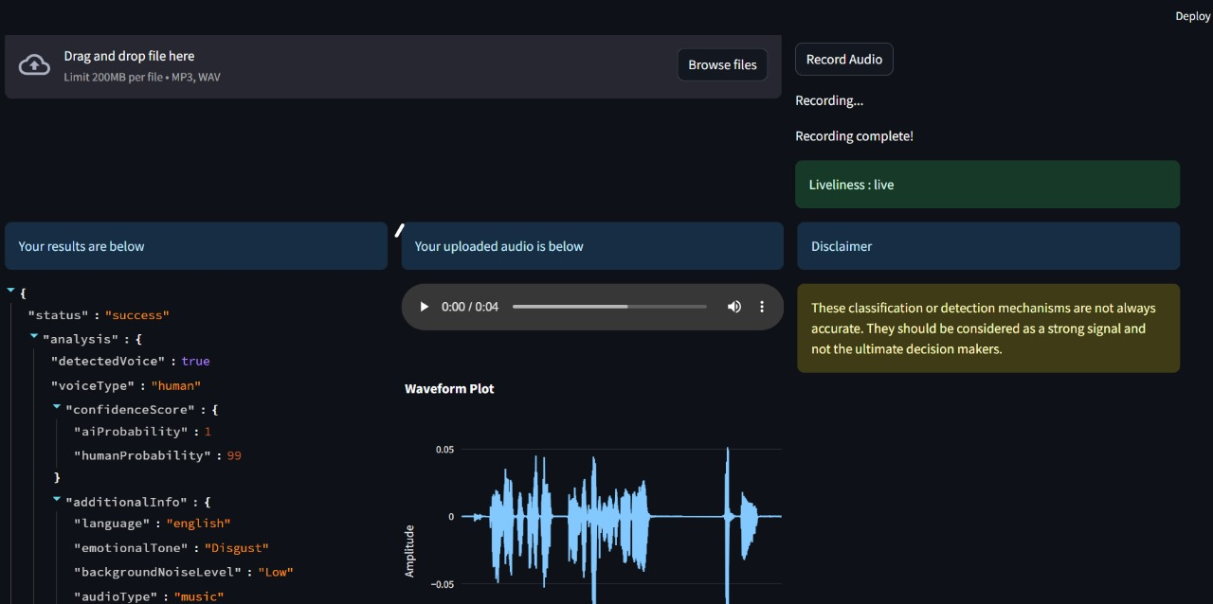
Liveliness feature
Liveliness Detection

Slide 8
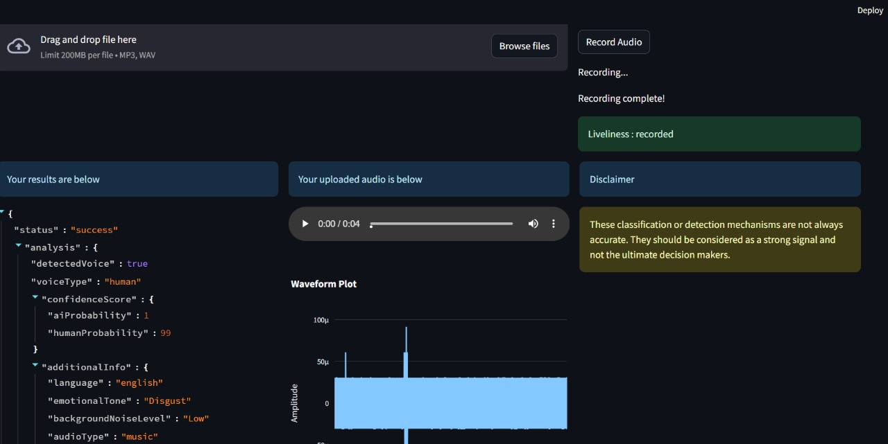
Liveliness feature
Liveliness Detection : Recorded

Slide 9
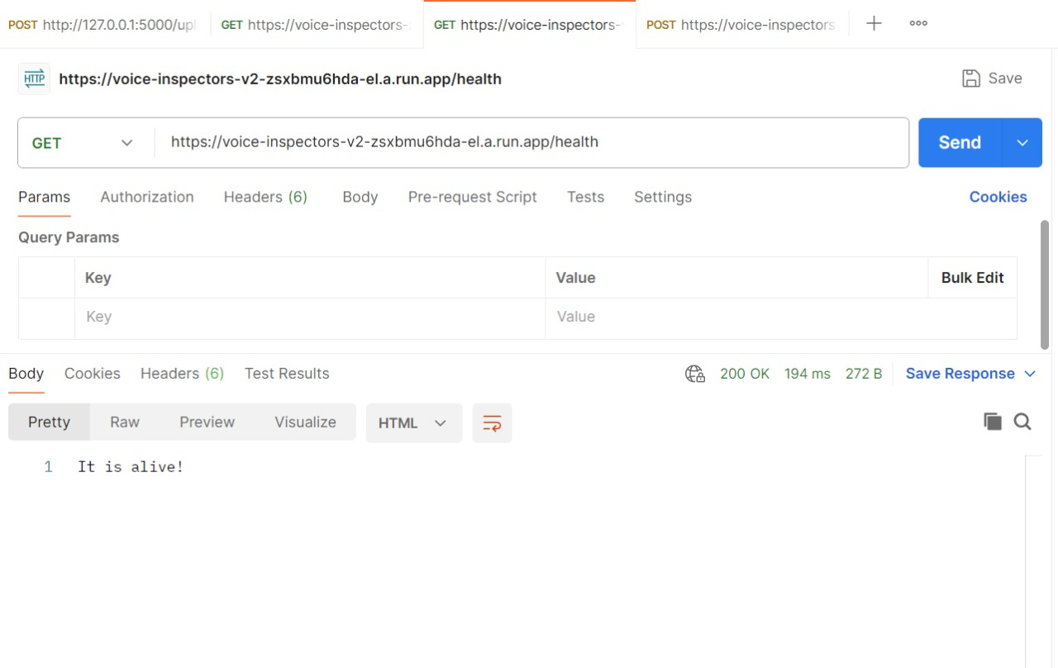

API Responses
Health Check

Slide 10
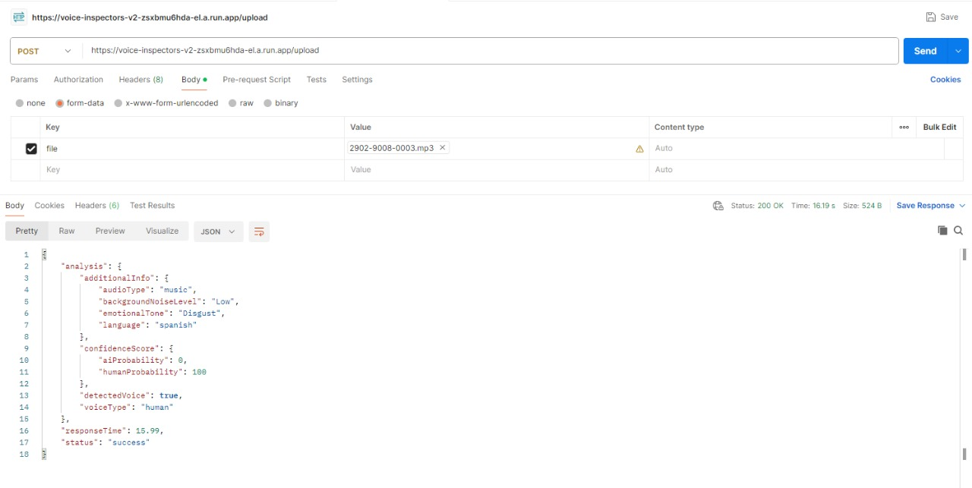

API Responses
Success Response

Slide 11
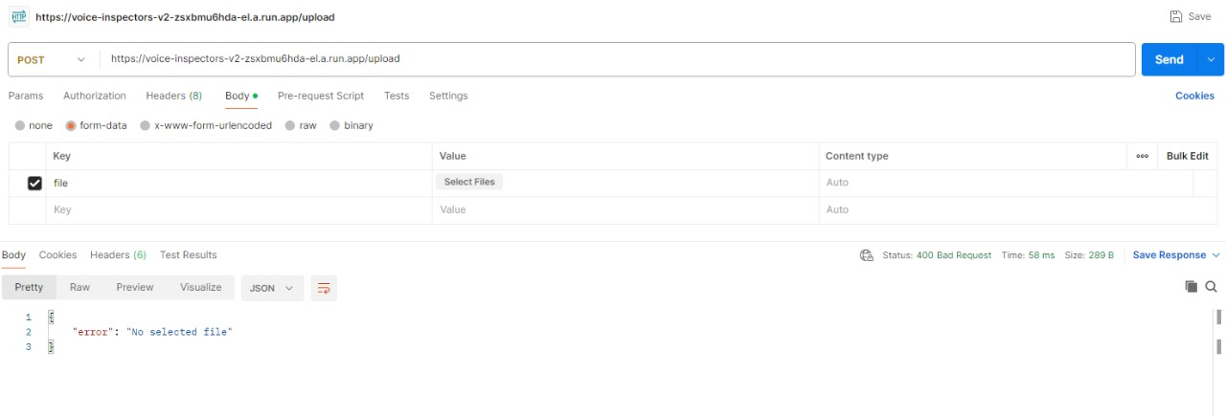

API Responses
No file Selected

Slide 12
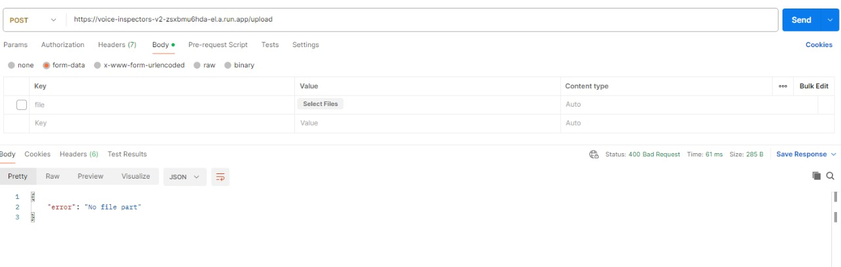

API Responses
Empty Input

Slide 13
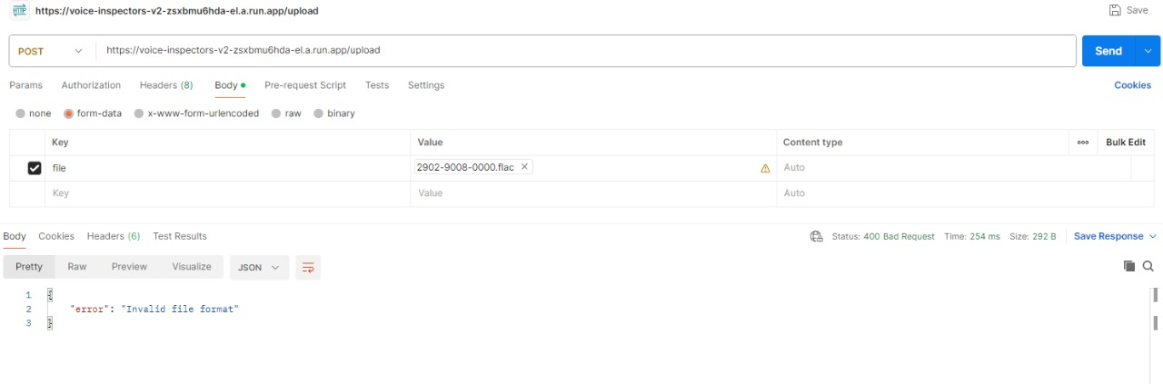

API Responses
Invalid File

Slide 14
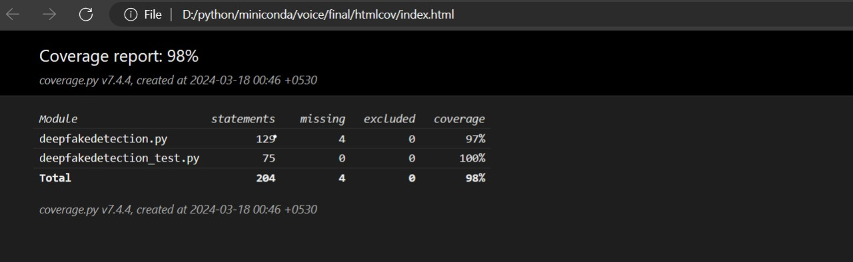
Code Coverage

Slide 15
Thank y u

